Slide 1
The Swedish Police –
Gender Equality

Slide 2
Agenda
Short presentation of the Swedish Police
Gender history and statistics
Recruiting to the Police Academy – how to improve the selection process for a more gender equal organization
National supply programs for future leaders and managers – how to increase women to management positions
Summarize
Questions and Reflections
The mission of the Police is to reduce crime and increase public safety

Slide 3
Our mission
Minska brottsligheten och öka tryggheten i samhället
The mission of the Police is to reduce crime and increase public safety

Slide 4
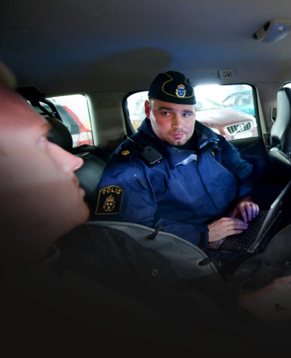
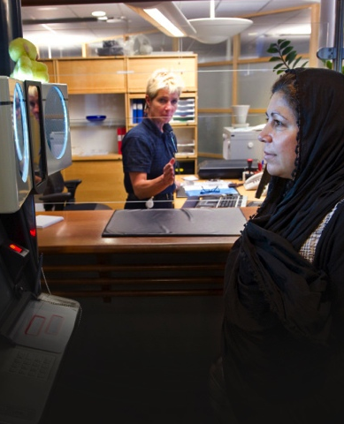
The main tasks of the Swedish Police
Provide the public with protection, information and other forms of assistance whenever such assistance is best given by the Police
Prevent crime and other disturbances of public order or safety and take action when such disturbances occur
The Police conducts surveillance and investigation concerning crimes which fall under public prosecution

Slide 5
The goals of the Swedish Police
Lower crime rate
Solve more crimes
Contribute to the public’s sense of safety
Increase police visibility
Maintain and strengthen people’s confidence in the Police
From the Guidelines of the National Police Commissioner 2011

Slide 6
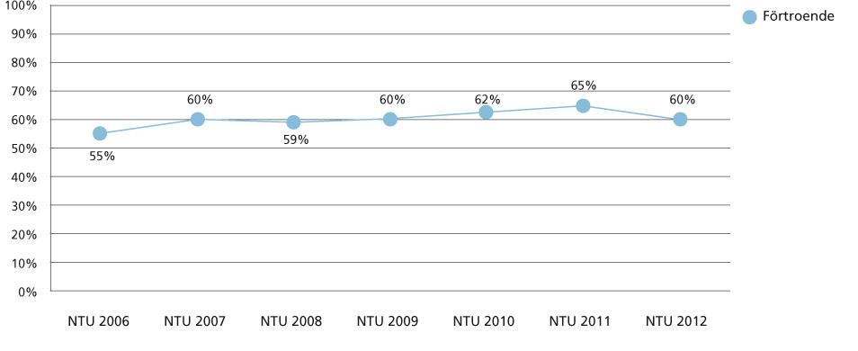
The public confidence in the Police
Confidence
60 per cent have a high degree of trust in the Police
Out of all public institutions, the Police has one of the highest levels of public confidence
From the Swedish National Council for Crime Prevention 2012, Brå

Slide 7
The Swedish Police 2013
28 500 employees
20 000 Police officers
Women 42%
Swedish National Police Board
21 Police Authorities
County Police Commissioner
1 500 000 crimes / year
20 405 millions kronor

Slide 8
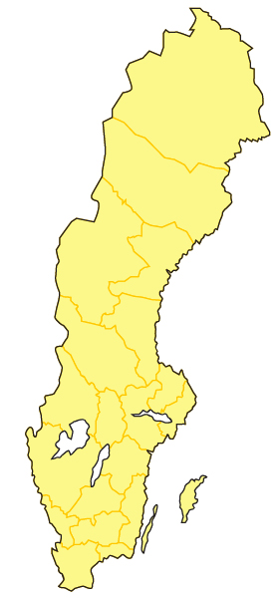
The Police organization – today
Government
The Ministry of Justice
The National Police Board
The National Bureau of Investigation The National Security Service The Police Academy
The Swedish National Laboratory of Forensic Science
21 Police Authorities
Notes:
8

Slide 9
The Police organisation – 2015
Government
The Ministry of Justice
The Swedish Police
7 National Police Departments
7 Police Regions
Notes:
9

Slide 10
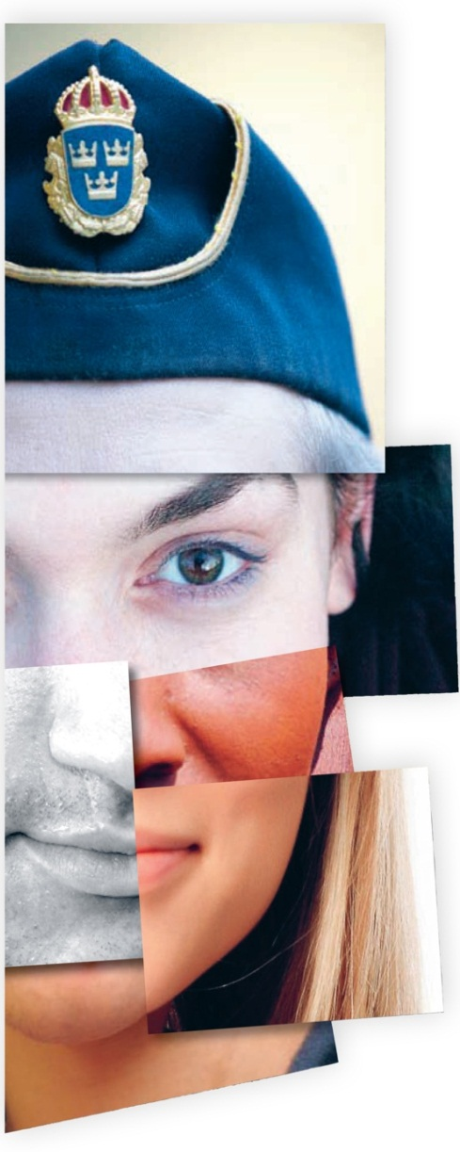
Our core values
Committed – showing responsibility and respect. We assume responsibility for our work and respect the equal worth of all
Efficient – with results and development in mind. We focus on results, cooperation and continuous development
Available – to the general public and to each other. We are flexible, supportive and ready to help

Slide 11
Why is gender equality so important?

Slide 12
Statistic – equality General
All female
employees
2000 33%
2008 39%
2009 39%
2010 39%
2011 40%
2012 41%
2013 42%
Female police
officers
2000 17%
2008 25%
2009 26%
2010 27%
2011 29%
2012 29%
2013 30%

Slide 13
Statistic – equality Police academy
Female police trainees at
the Police academy
2008 35%
2009 49%
2010 50%
38%
34%

Slide 14
Statistic – equality Competence category - managers
Female police Female civil All female officers employees employees
2008 16% 59% 22%
2009 18% 59% 23%
17% 59% 23%
18% 61% 24%
19% 62% 25%
19% 63% 25%

Slide 15
Recruiting to the Police academy
How to create a sustainable and transparent gender equality in the Police service
Sustained and transparent recruiting process to the Police Academy
Profile of requirement that is gender quality secured and based on a basic competence level for a Police officer
Working environment that is gender quality secured

Slide 16
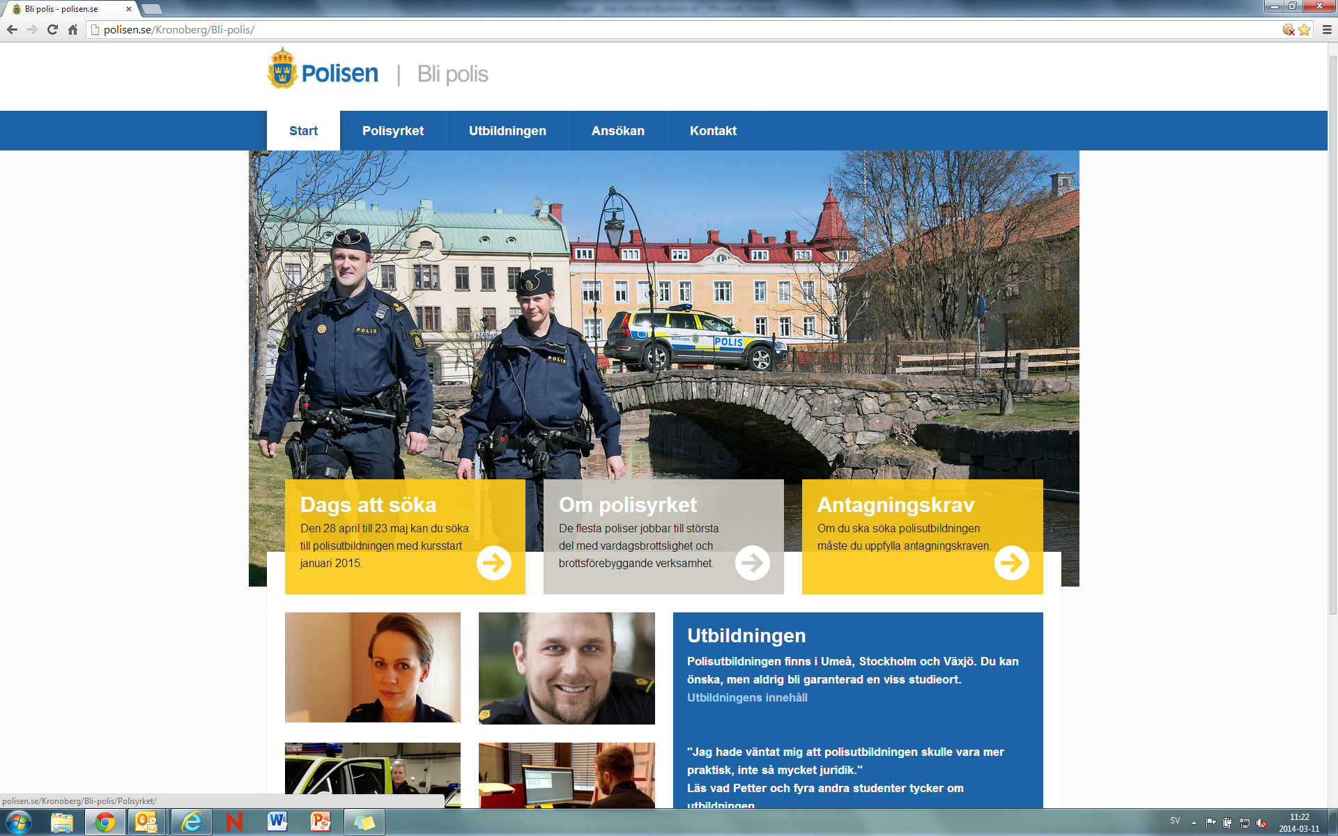

Slide 17
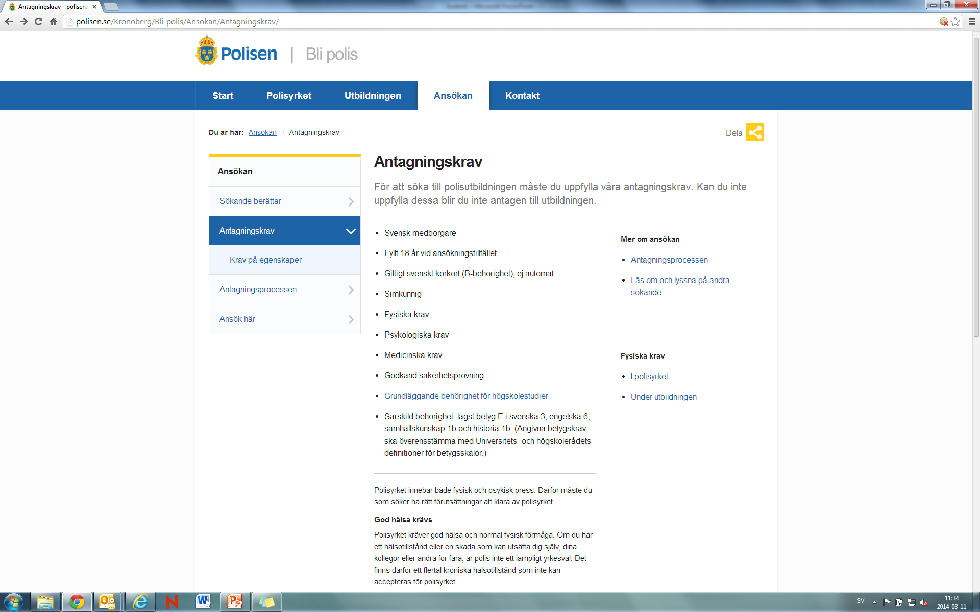

Slide 18
Behavioral criteria for a Police officer
Personal maturity
Responsive and flexible
Engaged and responsible
Patient and accurate
Communicative

Slide 19
Policy for employees
Requirements, Expectations and Opportunities
How to act in your mission
Three leadership-levels
First line management
Middle management
Strategic management
Three roles
Operation manager
Employers´ role
Leadership

Slide 20
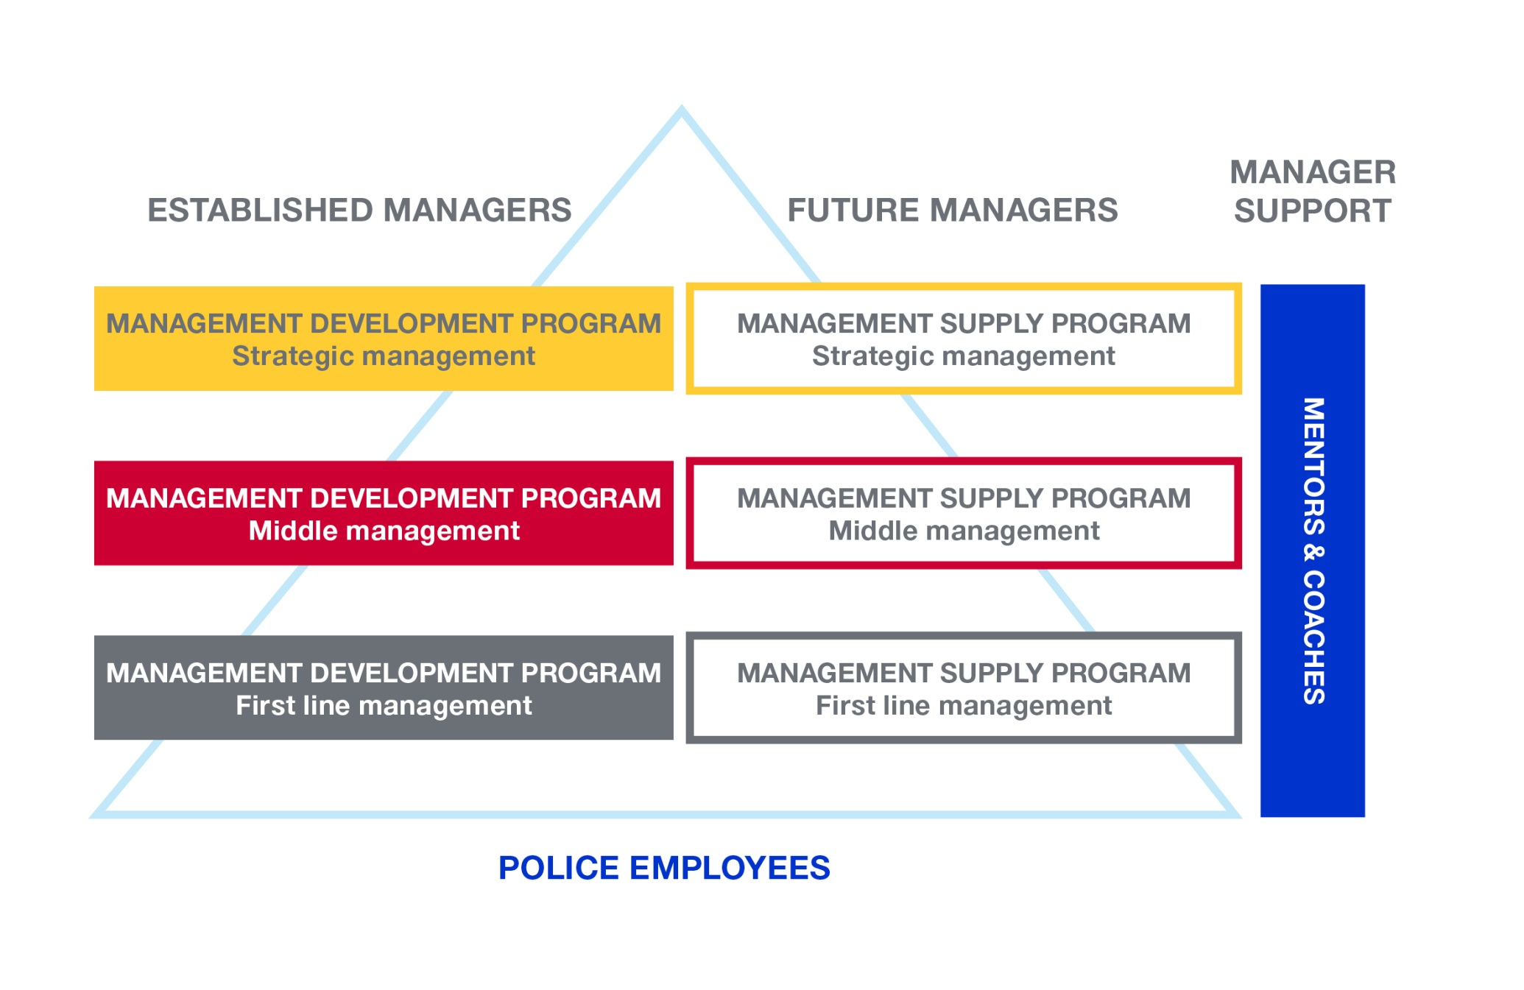
Management and leadership system

Slide 21
Needs from the Police service
Swedish Police
RESULTS
Management supply process
STRATEGIC PLANNING
A
I
D
R
S
ASSESS-MENT

Slide 22
Competence based selection
A method for recruitment of managers and selection to
management supply program: Behavioral criterias for
leadership
Competence based selection – Internet Assessments (MAP and Matrigma)
Competence based interviews
Competence based references
Competence based feedback
Identify and recruit people with good potential to fulfill the task

Slide 23
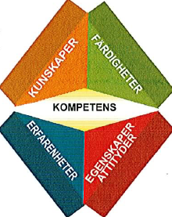
Competence profile
Knowledge
Experience
Skills
Properties and attitudes

Slide 24
Behavior criterias for leadership
Framework for assessment for management supply programs
Also used for recruiting and developing managers
Criterias
Objectives and results
Analysis and holistic views
Development and change management
Verbal and written communication
Social skills and assurance
Ability to create participation and motivation

Slide 25
Management supply process
How to create a sustainable and transparent gender equality to the management level
Clarify the managerial role
Implement an open and transparent recruitment process
Develop criterias for management and leadership
Identify all managers out of competence
Develop future managers before employment

Slide 26
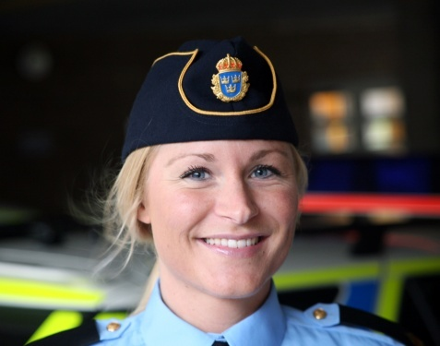
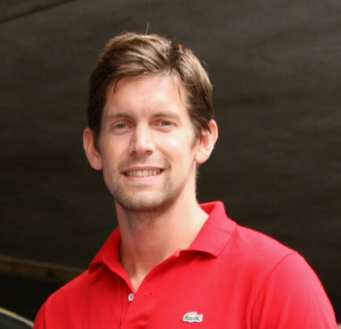
Management supply program – First line, Middle and Strategic management
To ensure future supply of managers with gender equality for the First, Middle and Strategic management level
Process: Attraction, Identification, Development
Assessment process based on behavioral criteria's for leadership
Individual programs containing theoretical studies and “on the job” training

Slide 27
Statistic – Management supply program Examined women
First line Middle Strategic
management management management
2013 50% 43% 20%

Slide 28
Lesson learned
Competence based selection for recruitment of managers and selection to management supply program secure that a person have the right behavior and properties to be a managers and a leader
An open and transparent recruitment process gets more women into leadership positions
Management supply programs develop and provide better conditions for an employee before she or he gets the management position.
All of this support and leads to gender equality

Slide 29
Summarize

